Slide 1

Super Enhanced Field-of-View
(S.E.F)
Space Wearables

Slide 2
The Problem
The Solution
Faced with constantly changing scenarios, an astronaut’s ability to react is often constrained by gear and utilities which don’t facilitate real-time feedback.
A wireless individual network integrates multiple scalable modular devices allowing for on-demand display and transfer of real-time data to astronauts and mission crew.

Slide 3
Approach
Features
Super Enhanced Field-of-View expands the astronaut's ability during extravehicular activity by feeding data from modular devices through a central microcomputer to a Heads-Up-Display.
Modular Components
Adaptability to Mission
Intercommunication
Redundancy

Slide 4
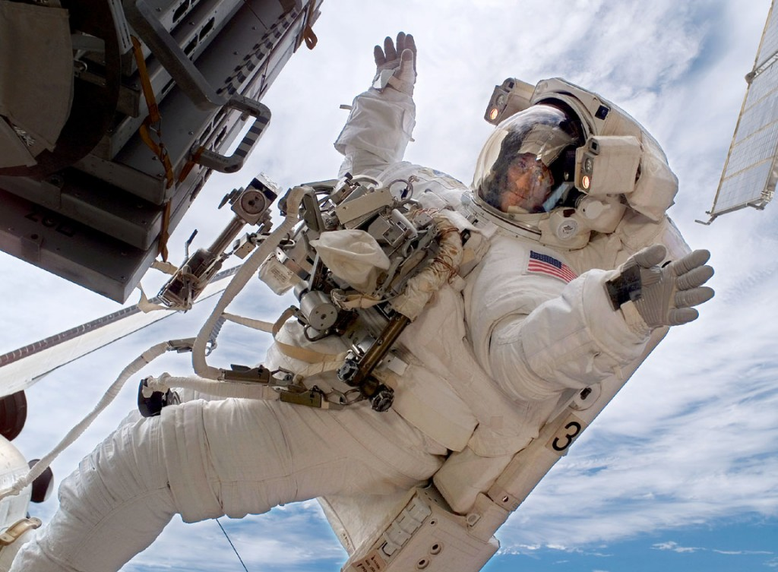
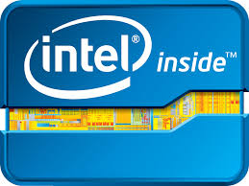

Slide 5
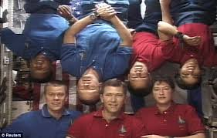
Wearable Microcomputer
The wearable microcomputer is an internally mounted device that interfaces with the current Display and Control Module for space suit life support readings.
It acts as a HUB and wireless router allowing for transfer of real-time data between the astronaut and mission crew.

Slide 6
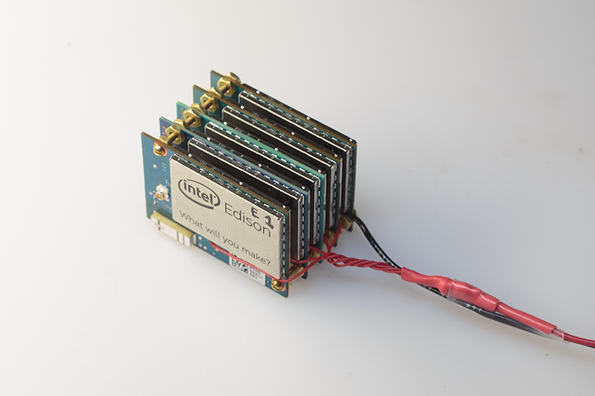
Implementation
Intel’s Edison Platform
Compact and Low Cost
High Performance/Low Power
Scalable, WiFi/Bluetooth Enabled
Cluster for Increased Processing

Slide 7
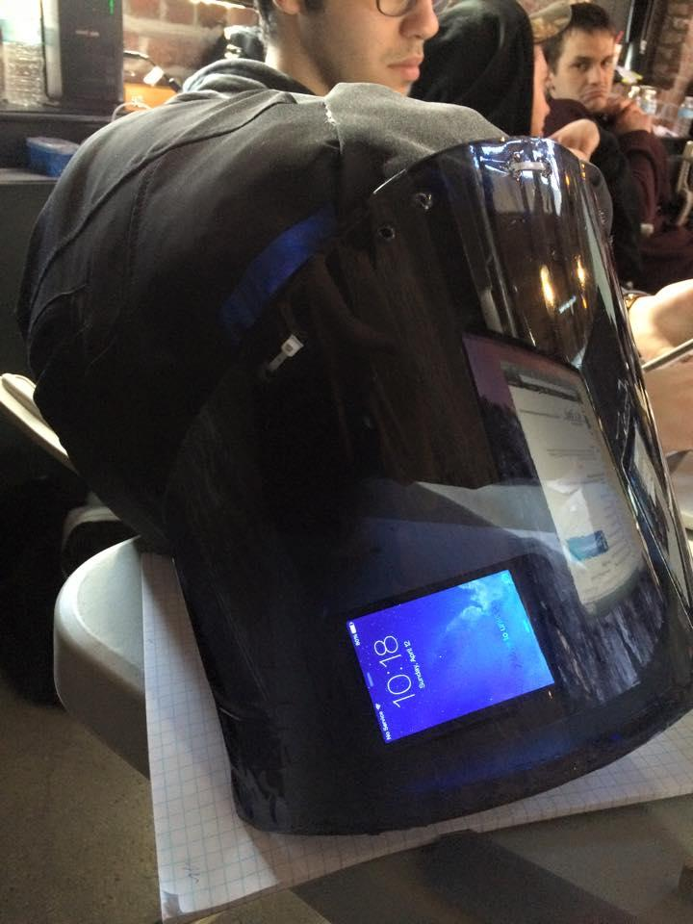
Heads-up Display
Displays real-time feedback to the astronaut via reflections from LCD displays strategically placed within the helmet.
Practical and Simple
Low Power Consumption
Inexpensive

Slide 8
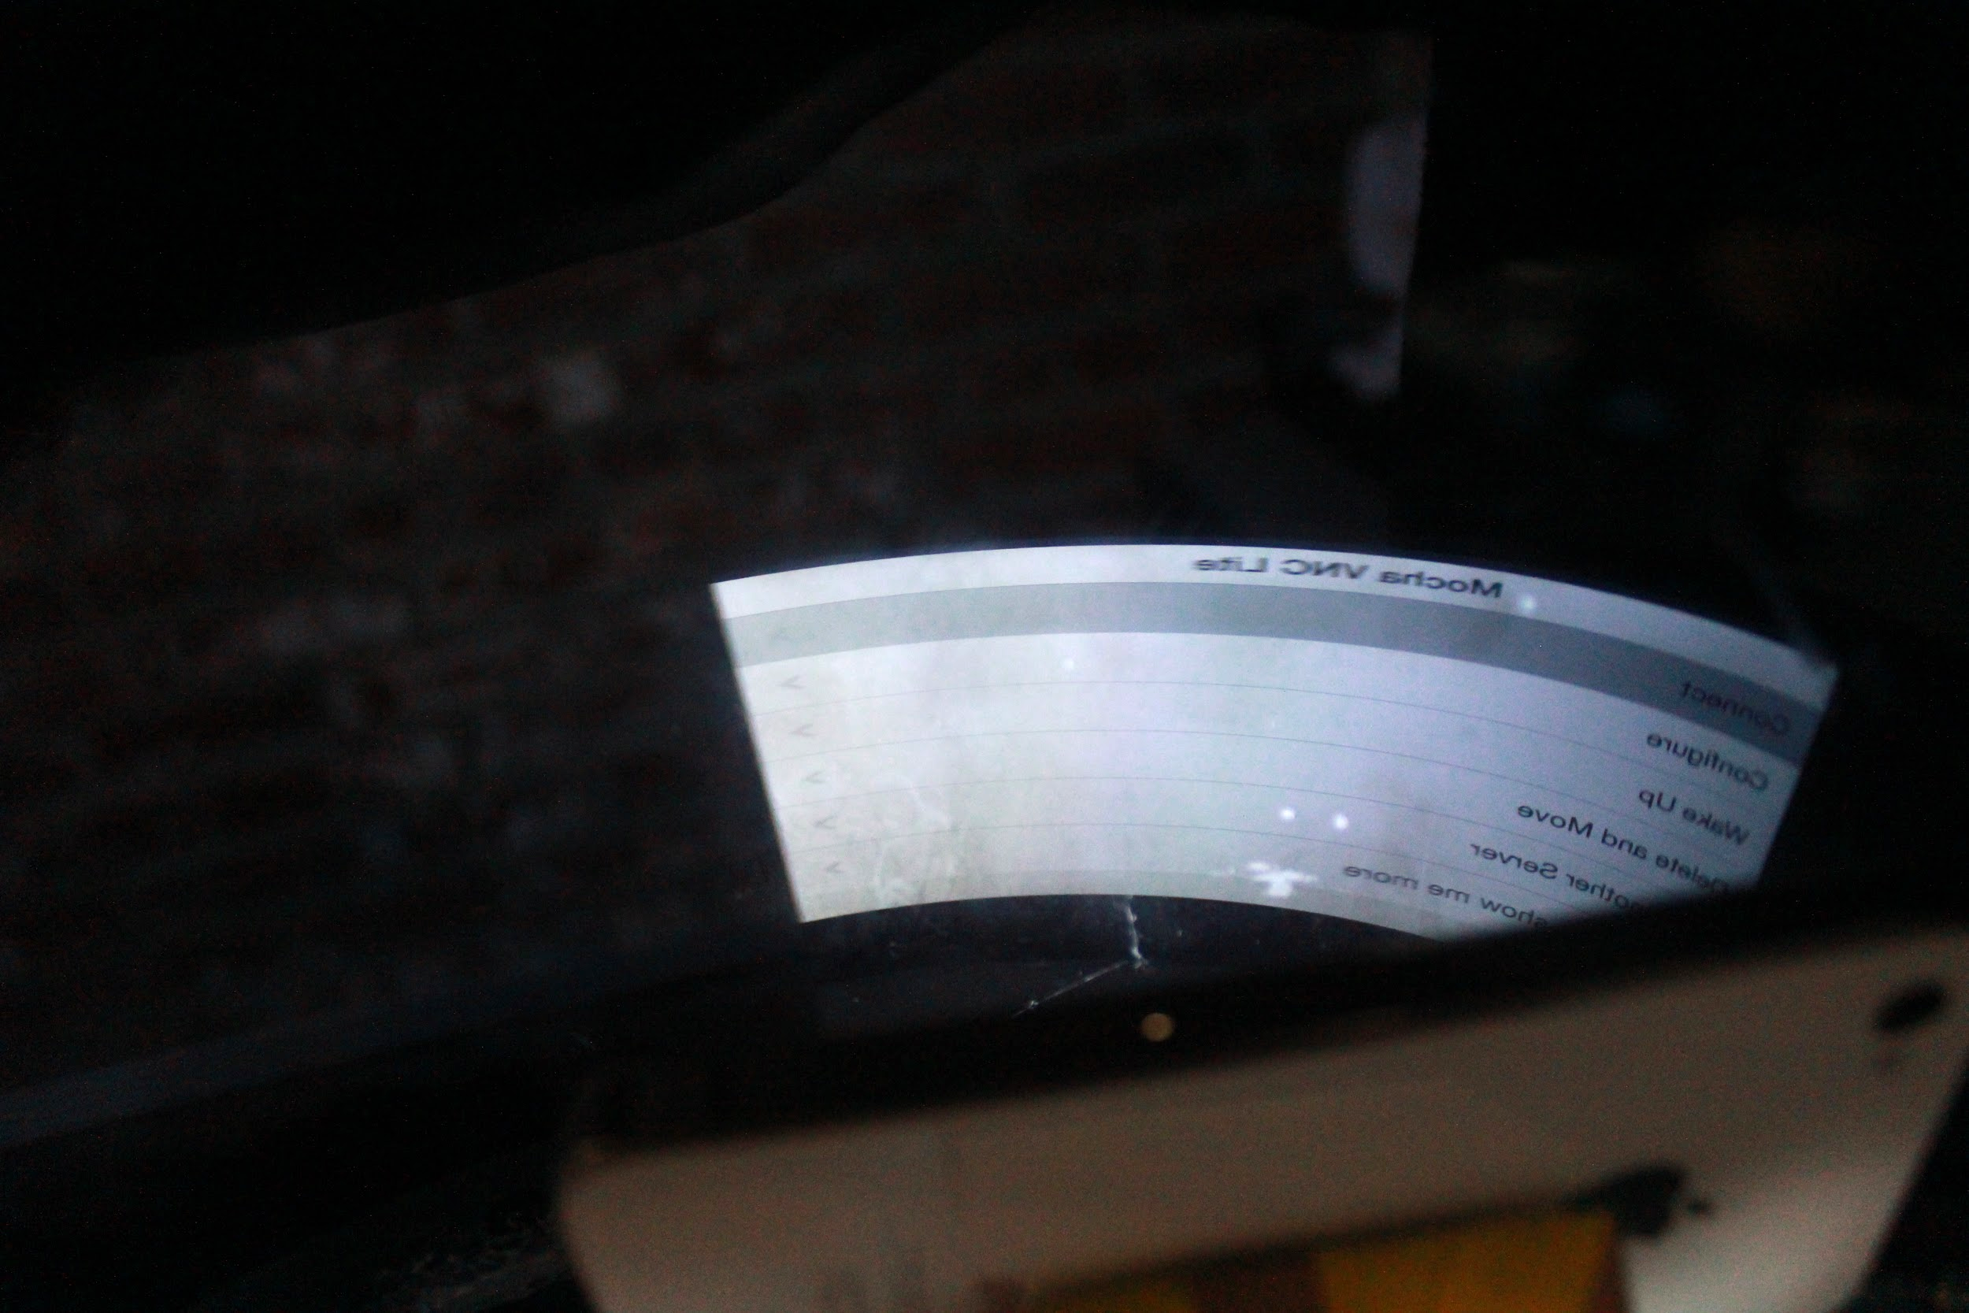
Implementation
Dual Flex LCD screens for reflection image display within helmet
Wired connection to wearable computer for fast data transfer

Slide 9
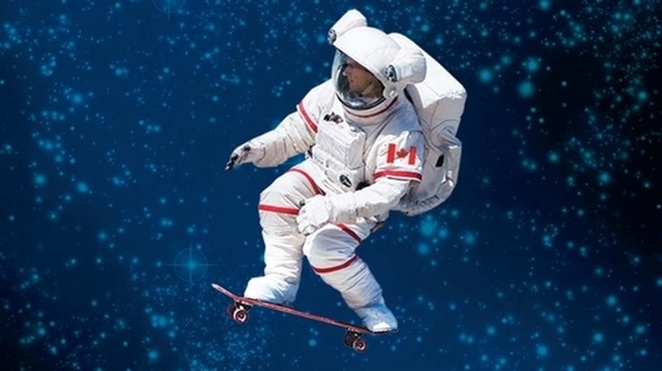
Adaptability?
Every mission presents its own unique challenges
Every mission requires specific toolsets

Slide 10
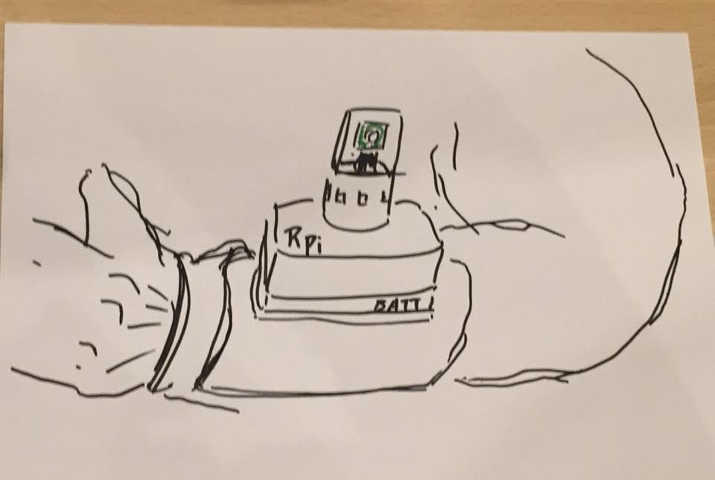
Modular Universal Device
Provides a universal power supply along with an Internet-of-Things base, extending interfacing devices’ (cameras, sensors, etc.) real-time feedback to both control and/or astronauts.
Prototypes

Slide 11
Implementation
Intel Edison microcomputer provides external devices a interface to the individual network
Bayonet-mounting plate provides a universal attachment for easy interchangeability.
Strategically placed velcro for freedom of placement

Slide 12
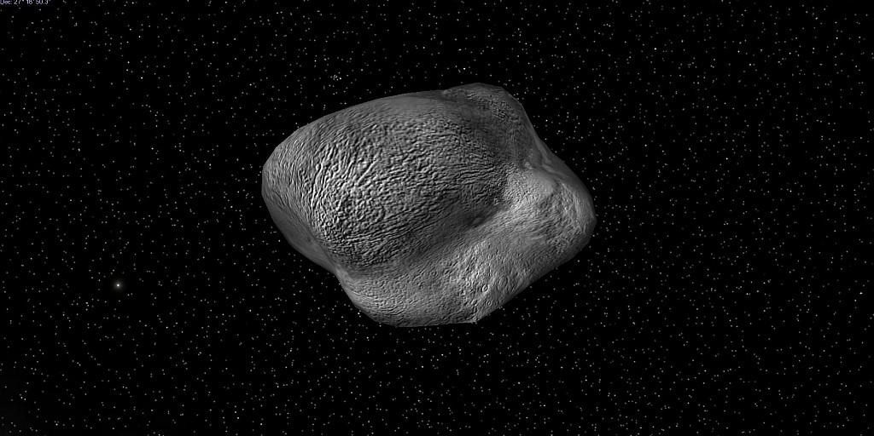
Bluemix Integration
Using Bluemix, the S.E.F. will utilize cloud processing to complete more complex tasks.
3D imaging
External environment readouts.

Slide 13
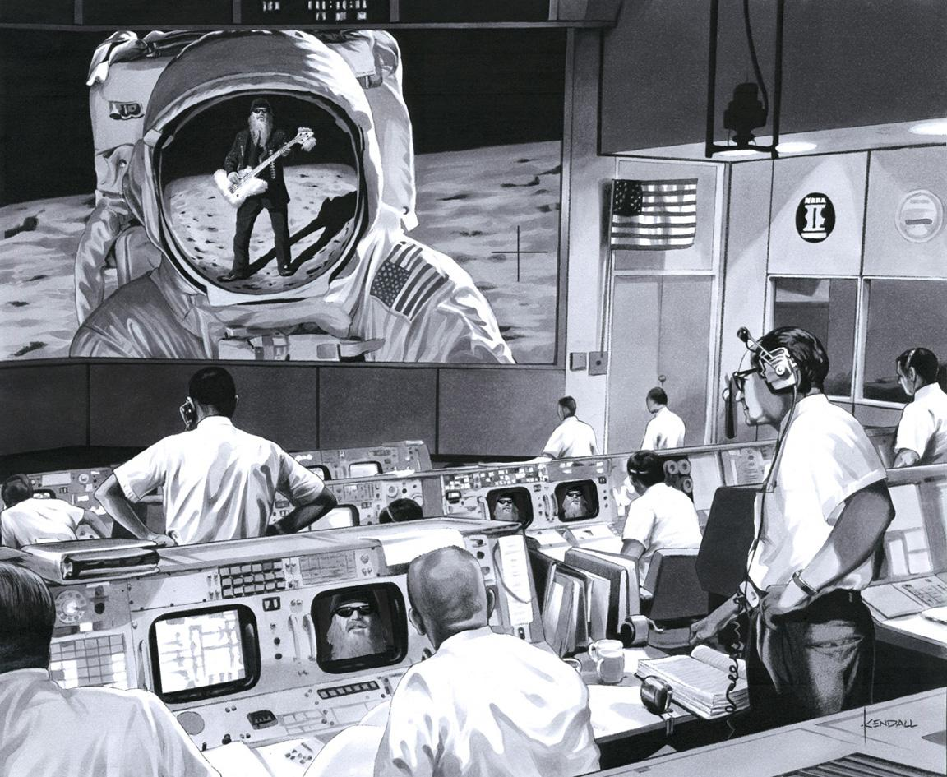
Thank You!!!

